Slide 1
Introducing R and Data Science
What time do investment bankers get to work?
REAL Analytics

Slide 2

Course Philosophy 1. Falling in success "you should be able to think of data analysis and your fingers will automatically do the typing" - Hadley Wickham 2. Learning from peers 3. Showcasing useful resources

Slide 3
Session Roadmap
Introduction: NYC Taxi Data illustrates the data science workflow
Discussion - Why are we learning R?
Overview of Beginner Concepts
Beginner Concepts one-by-one
dataset: who’s coming into New York?
Recitation (consolidation and extension)
dataset: mother-tongue exams
REAL Analytics

Slide 4
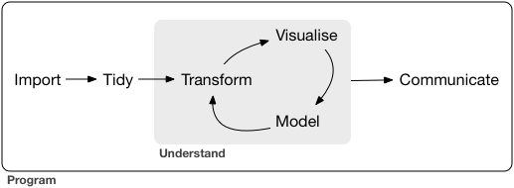
If you only learn one thing -
Data Science Workflow

Slide 5
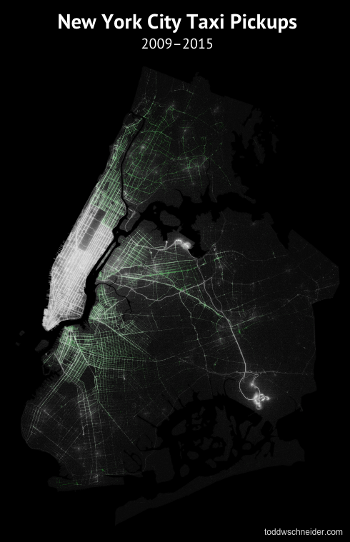
Analyzing 1.1 Billion NYC Taxi and Uber Trips, with a Vengeance
Question
What time do investment bankers get to work?
In the movie Die Hard, Could Bruce Willis and Samuel L. Jackson have made it from 72nd and Broadway to Wall Street in less than 30 minutes?
http://toddwschneider.com
REAL Analytics
Notes:
Illustration of workflow should be a hand-out for participants to refer to.

Slide 6
Analyzing 1.1 Billion NYC Taxi and Uber Trips, with a Vengeance
Import : Combine datasets from Uber and NYC Taxi and Limousine Commission
Tidy : Standardise dates, deal with missing values, rename variables
Transform : Subset data to dropoffs at the Goldman Sachs driveway
Visualise + Model + Communicate : Create a histogram with titles and axes labels

Slide 7
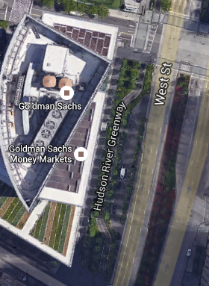
What Time Do Investment Bankers Get to Work?

Slide 8
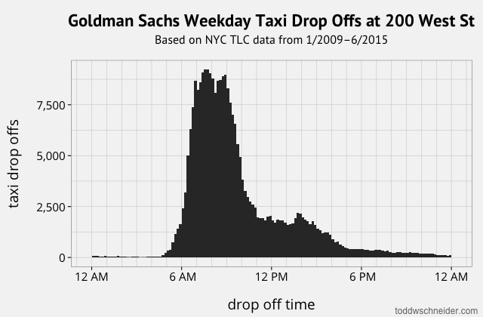
What Time Do Investment Bankers Get to Work?
Notes:
The cabs start dropping off around 5 AM, then peak hours are 7–9 AM, before tapering off in the afternoon. Presumably most of the post-morning drop offs are visitors as opposed to employees. If we restrict to drop offs before 10 AM, the median drop off time is 7:59 AM, and 25% of drop offs happen before 7:08 AM.

Slide 9
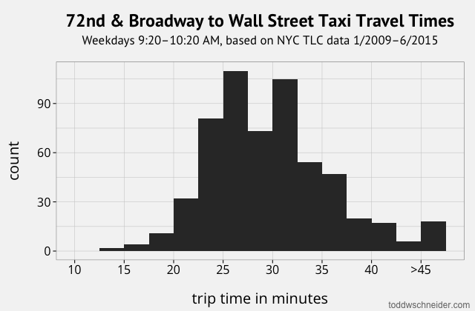
No problem at all….
http://toddwschneider.com/page/2/
REAL Analytics
Notes:
http://toddwschneider.com/page/2/
There are 580 such taxi trips in the dataset, with a mean travel time of 29.8 minutes, and a median of 29 minutes. That means that half of such trips actually made it within the allotted time of 30 minutes! Now, our heroes might need a few minutes to commandeer a cab and get down to the subway platform on foot, so if we allot 3 minutes for those tasks and 27 minutes for driving, then only 39% of trips make it in 27 minutes or less. Still, in the movie they make it seem like a herculean task with almost zero probability of success, when in reality it’s just about average. This seems to be the rare action movie sequence which is actually easier to recreate in real life than in the movies!

Slide 10
Short Discussion
Why are we learning R?
Excel graphs look terrible?
Want to process larger datasets?
Want to explore machine learning?
REAL Analytics

Slide 11
Beginner Concepts
Installing RStudio
Setting Directories
Loading and Reading data
Base R Commands
Basic R Programming
REAL Analytics

Slide 12
Installing RStudio
Efficiently Googling for answers is crucial to learning R. Let's start now
1. Google "download R"
2. Google "download R Studio"
REAL Analytics

Slide 13
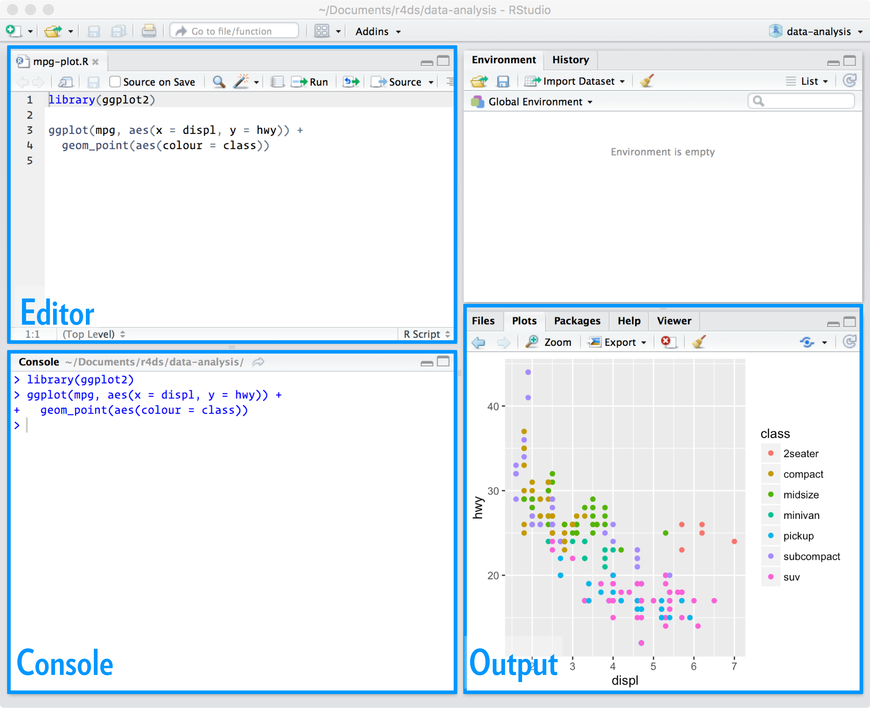
R Studio Layout
Notes:
keep all the files associated with a project together — input data, R scripts, analytical results, figures.

Slide 14
Setting Directories – Where does your analysis live?
getwd()
setwd(“./Desktop”)
REAL Analytics

Slide 15
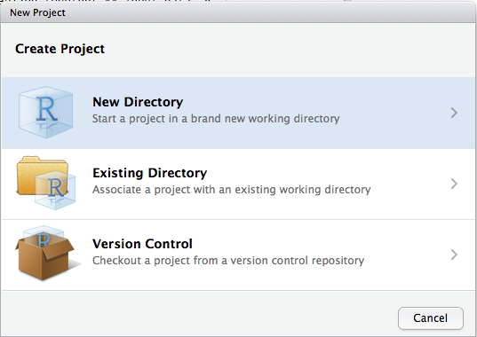
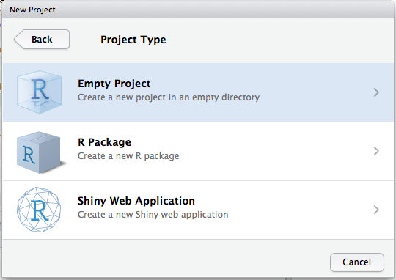
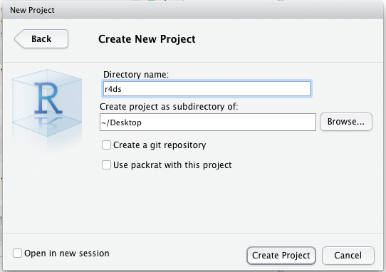
R Studio Layout

Slide 16
Question: Will your flight be delayed?
Step 1: Loading and Reading data
# We will look at flight arrivals into New York
# The data comes in a package. This code loads the package
install.packages("nycflights13")
library(nycflights13)
REAL Analytics

Slide 17
Base R Commands: What is the whole dataset like?
> str(flights)
Classes ‘tbl_df’, ‘tbl’ and 'data.frame': 336776 obs. of 19 variables:
$ year : int 2013 2013 2013 2013 2013 2013 2013 2013 2013 2013 ...
$ month : int 1 1 1 1 1 1 1 1 1 1 ...
$ day : int 1 1 1 1 1 1 1 1 1 1 ...
$ dep_time : int 517 533 542 544 554 554 555 557 557 558 ...
REAL Analytics
Notes:
Note the concept of data stored as a vector within a data frame,as well as the different data types like"factor"and "integer". Other data types include "chr" and "numeric"

Slide 18
Base R Commands: What is the whole dataset like?
head(flights)
year month day dep_time sched_dep_time dep_delay arr_time sched_arr_time arr_delay carrier
1 2013 1 1 517 515 2 830 819 11 UA
2 2013 1 1 533 529 4 850 830 20 UA
3 2013 1 1 542 540 2 923 850 33 AA
4 2013 1 1 544 545 -1 1004 1022 -18 B6
5 2013 1 1 554 600 -6 812 837 -25 DL
6 2013 1 1 554 558 -4 740 728 12 UA
REAL Analytics

Slide 19
Base R Commands: What is the whole dataset like?
> summary(flights)
dep_time sched_dep_time dep_delay arr_time
Min. : 1 Min. : 106 Min. : -43.00 Min. : 1
1st Qu.: 907 1st Qu.: 906 1st Qu.: -5.00 1st Qu.:1104
Median :1401 Median :1359 Median : -2.00 Median :1535
Mean :1349 Mean :1344 Mean : 12.64 Mean :1502
3rd Qu.:1744 3rd Qu.:1729 3rd Qu.: 11.00 3rd Qu.:1940
Max. :2400 Max. :2359 Max. :1301.00 Max. :2400
NA's :8255 NA's :8255 NA's :8713 #missing values
REAL Analytics

Slide 20
Getting help
Google
??max
Stack Overflow (forum)
R Bloggers
Vignettes
REAL Analytics

Slide 21
Mini Review
1. Choose a command and explain it to the person next to you
2. What question would you like to ask from the data?
REAL Analytics

Slide 22
Base R Commands: Drilling down into the data
> head(flights$origin)
[1] "EWR" "LGA" "JFK" "JFK" "LGA" "EWR"
> tail(flights$origin)
[1] "LGA" "JFK" "LGA" "LGA" "LGA" "LGA"
REAL Analytics

Slide 23
Base R Commands: Drilling down into the data
> max(flights$arr_delay, na.rm=TRUE)
> min(flights$arr_delay, na.rm-TRUE)
Getting help: how would you find the average?
REAL Analytics

Slide 24
Segue into Basic R Programming
1. Calling functions
summary(), str() etc. are called "functions" that we "call" to get R to do things for us
2. R is a calculator
Example: sin(pi/4)
Example: 1/400*50
3. Creating Objects and Assigning Names
data_summary <- summary(arrivals) *note the snake case

Slide 25
Recitation
The motherTongue dataset contains the Percentage of GCE O-Level Students Who Passed Mother Tongue Language
Download the data
How would you use baseR commands to explore the data?
REAL Analytics

Slide 26
What have we learnt?
Interacting with RStudio
Navigating directories
Loading data
Exploring data with basic commands
REAL Analytics

Slide 27
If you want to level up, explore:
subset() function
apply() family of functions
Slicing in base R
REAL Analytics

